Slide 1
Network Analysis of Steroids in the MLB
Jake Arendsen, Adil A Kumar, Halle Steinberg

Slide 2
Agenda
1
2
3
4
5
6
About Our Data
Descriptive Statistics
Next Steps
Background on Mitchell Report
Questions to Answer
Initial Findings & Analysis

Slide 3
Background on Mitchell Report
What?
The Mitchell Report, named after former U.S. Senator George J. Mitchell, was a serious, thorough investigation into doping in Major League Baseball.
Why?
The report was ordered by former Commissioner Bud Selig after he read Game of Shadows, an investigative, non-fiction account of renowned All-Star outfielder Barry Bonds’ drug use, as well as criticism from Congress about the tarnishing of baseball’s reputation.
Results
Though Mitchell heard from former players that possibly half of all major leaguers were on steroids, he only expressly named 89 players in the report.
Response
Responses to Mitchell Report included more expansive, frequent drug testing and more serious punishments upon positive tests.

Slide 4
Questions to Answer
What does the MLB steroid network look like?
What differentiates our suppliers?
Do we see obvious better performance for players on steroids?
Did the Mitchell Report have a serious impact on player performance?

Slide 5
About Our Data - Network Data
The data consists of an affiliation matrix with drug suppliers on the columns and players involved in the scandal on the rows
The value in the cell is a 1 if the player purchased drugs from that supplier, and a 0 if not
We also created two incidence matrices
“Players” explains the relationship between all players involved in the scandal - a 1 if the two players purchased from at least one of the same suppliers, and a 0 otherwise
“Dealers” explains the relationship between all dealers involved in the scandal - a 1 if the two dealers shared at least one player who purchased drugs from both dealers, and a 0 otherwise

Slide 6
Additional Data Collected
We also collected additional data to perform analysis and answer questions related to the player and dealer networks
Player
Personal
Stats
Years of Experience
Last Year Played
Location of Supplier
Performance Stats
Age
Wins/Losses that Year
WAR (Wins Above Replacement)
World Series Winner (Binary)
As of 2007
As of 2019
Major Award Winner (Binary)
All-Star Appearances

Slide 7
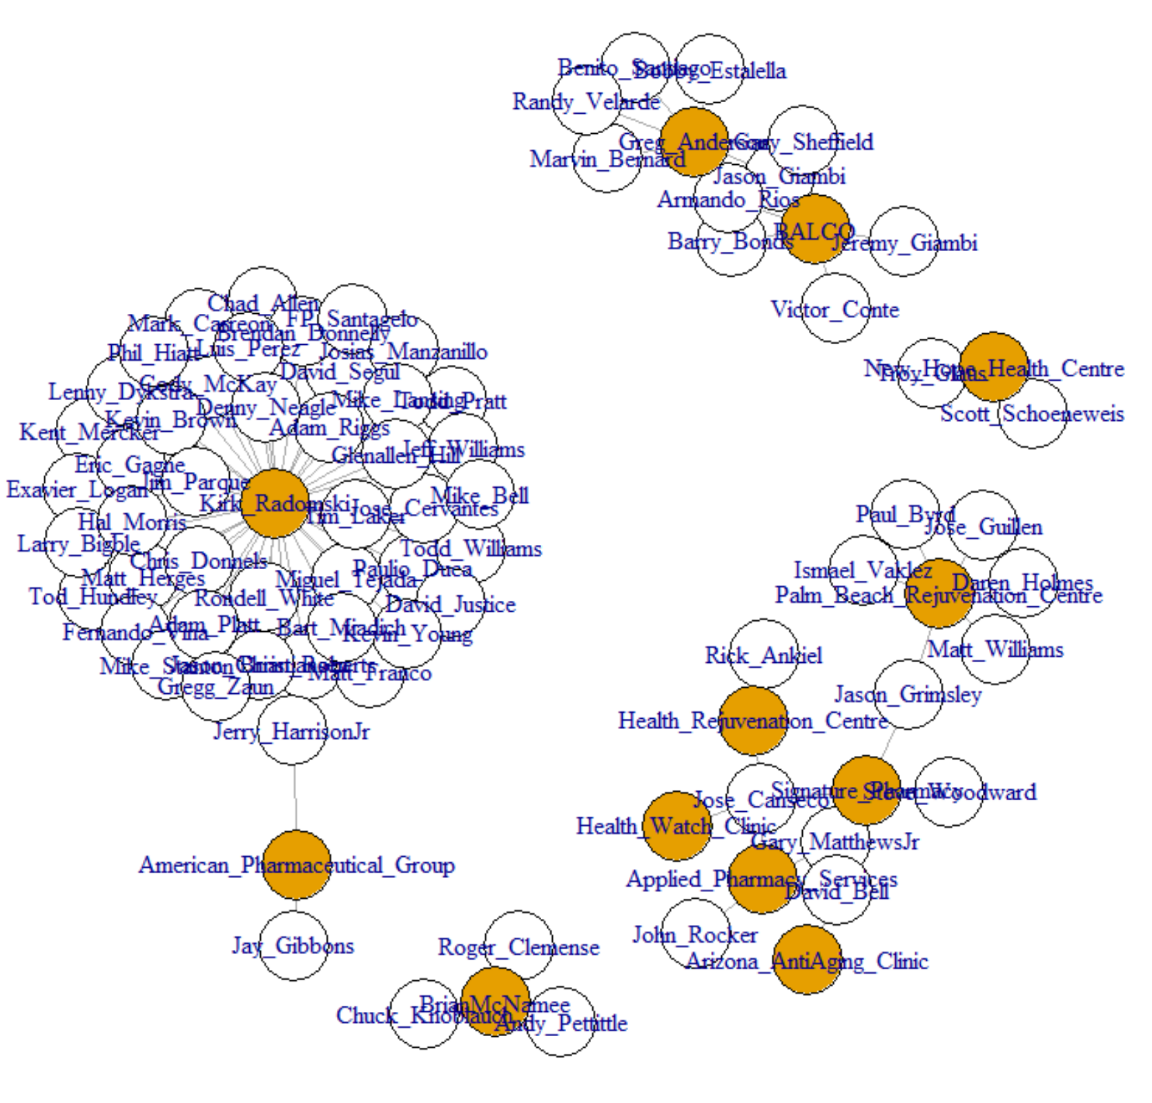
Player/Dealer Total Network
Player | Deg. | Close. | Betw. | PRank | Eigen Cent.
Je. Giambi | 1 | 0.000165 | 0 | 0.005852 | 2.49E-17
Ja. Giambi | 2 | 0.000165 | 3.75 | 0.009981 | 6.3E-17
G. Sheffield | 2 | 0.000165 | 3.75 | 0.009981 | 7.58E-17
B. Estalella | 1 | 0.000165 | 0 | 0.005915 | 3.32E-17
B. Santiago | 1 | 0.000165 | 0 | 0.005915 | 3.24E-17
M. Bernard | 1 | 0.000165 | 0 | 0.005915 | 2.87E-17
B. Bonds | 2 | 0.000165 | 3.75 | 0.009981 | 6.83E-17
*only showing first 7 players (not in order)
The total network consists of many clusters - lots of players with little degree/closeness
We can see the biggest cluster around Kirk Radomski - a bat boy for the New York Mets from 1985-1995. He later continued to deal as a personal trainer.

Slide 8
Similarity of Players within Total Network
Player | Average Jaccard Similarity
Je. Giambi | 0.073148
Ja. Giambi | 0.091667
G. Sheffield | 0.091667
B. Estalella | 0.092361
B. Santiago | 0.092361
M. Bernard | 0.092361
B. Bonds | 0.091667
44 players are tied for the highest average Jaccard similarity (0.58399), meaning they are more similar to other players on average
These 44 players are all part of the cluster of players tied to Kirk Radomski, the most central dealer in the network
*only showing first 7 players (not in order)

Slide 9
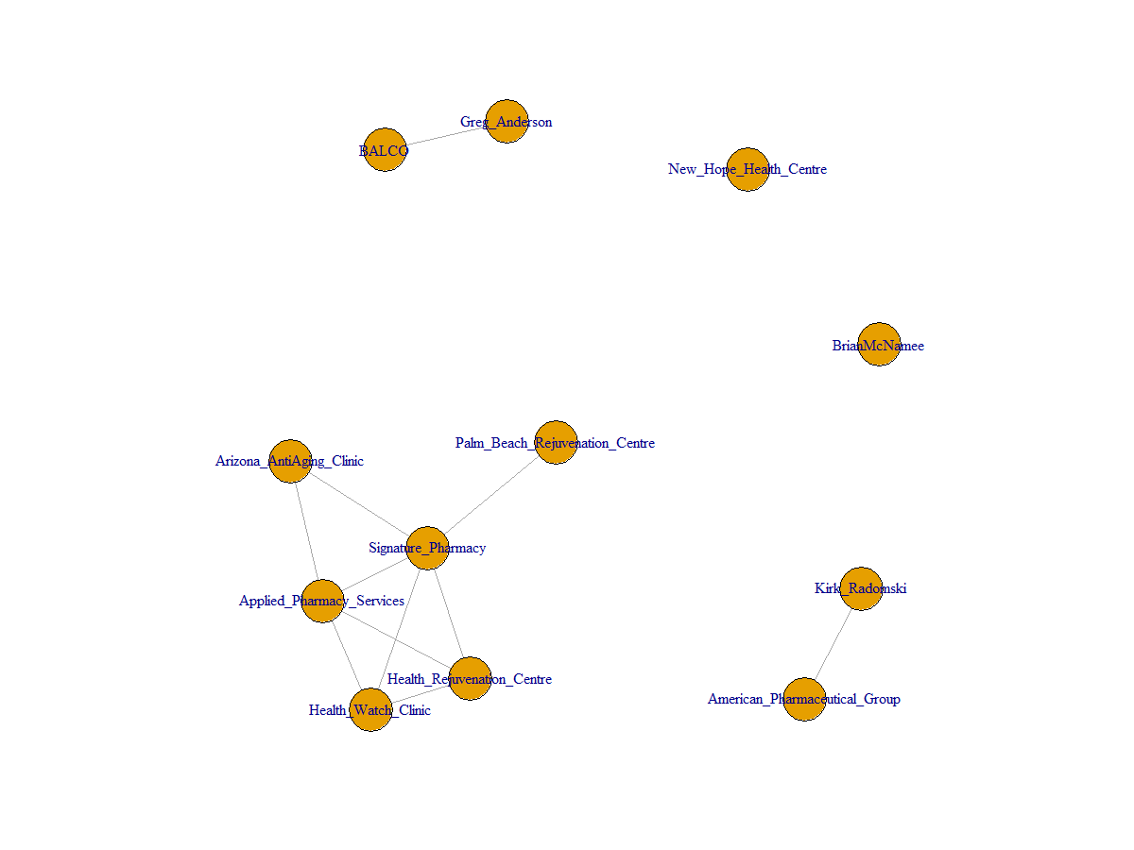
Dealer Network
Dealer | Deg. | Close. | Betw. | PRank | Eigen Cent.
BALCO | 1 | 0.008264 | 0 | 9.71E-02 | 0.00E+00
Greg Anderson | 1 | 0.008264 | 0 | 9.71E-02 | 1.02E-18
Palm Beach Rejuvenation Centre | 1 | 0.012346 | 0 | 4.16E-02 | 2.94E-01
New Hope Health Centre | 0 | 0.007576 | 0 | 1.46E-02 | 0.00E+00
Signature Pharmacy | 5 | 0.012987 | 5 | 1.59E-01 | 1.00E+00
American Pharmaceutical Group | 1 | 0.008264 | 0 | 9.71E-02 | 0.00E+00
Health Rejuvenation Centre | 3 | 0.012658 | 0 | 9.49E-02 | 8.04E-01
Applied Pharmacy Services | 4 | 0.012821 | 1 | 0.124242 | 9.33E-01
Dealer | Deg. | Close. | Betw. | PRank | Eigen Cent.
Arizona AntiAging Clinic | 2 | 0.0125 | 0 | 0.067989 | 5.68E-01
Health Watch Clinic | 3 | 0.012658 | 0 | 0.094869 | 8.04E-01
Kirk Radomski | 1 | 0.008264 | 0 | 0.097087 | 3.99E-18
BrianMcNamee | 0 | 0.007576 | 0 | 0.014563 | 0.00E+00
Dealers in the bottom left of the network are dealers of HGH
They were known for giving HGH prescriptions out without someone actually needing it or seeing a doctor
One of the key groups being targeted by Mitchell Report

Slide 10
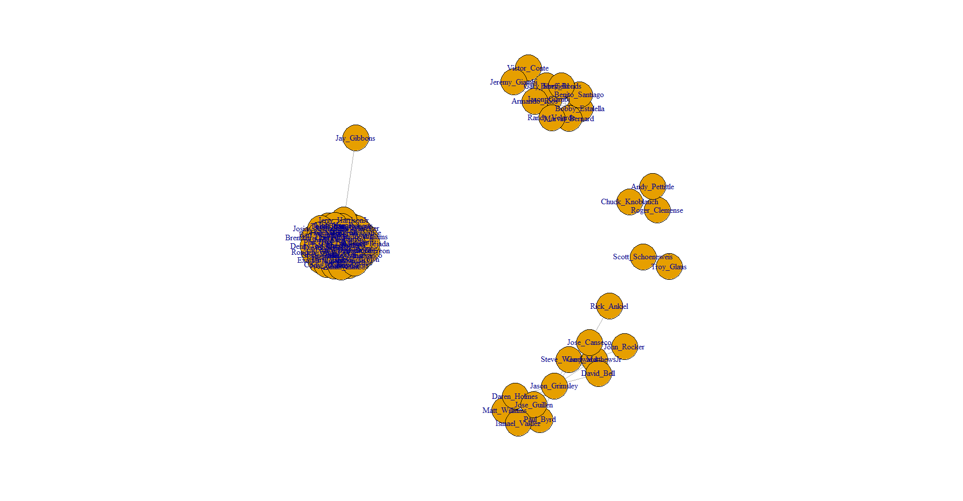
Player Network
Player | Deg. | Close. | Betw. | PRank | Eigen Cent.
Je. Giambi | 5 | 0.000223 | 0 | 1.01E-02 | 9.20E-17
Ja. Giambi | 9 | 0.000224 | 2 | 1.66E-02 | 1.38E-16
G. Sheffield | 9 | 0.000224 | 2 | 1.66E-02 | 4.60E-17
B. Estalella | 7 | 0.000223 | 0 | 1.31E-02 | 2.30E-17
B. Santiago | 7 | 0.000223 | 0 | 1.31E-02 | 4.60E-17
M. Bernard | 7 | 0.000223 | 0 | 1.31E-02 | 6.90E-17
B. Bonds | 9 | 0.000224 | 2 | 0.016571 | 4.60E-17
Many clusters - one large cluster consisting of players that got their drugs from Kirk Radomski
Jason Grimsley acts as a broker - he got drugs from both Palm Beach Rejuvenation Center and Signature Pharmacy, so he connects both of those groups

Slide 11
Potential Questions to Answer with Analysis
Are certain players "better" because they got drugs from certain dealers?
Does better performance indicate higher connectedness within the steroid network?
How does similarity among players and the dealers they get their drugs from influence a player’s career performance?
Example of a lemons problem
Does being more connected within the steroid network indicate better career performance?

Slide 12
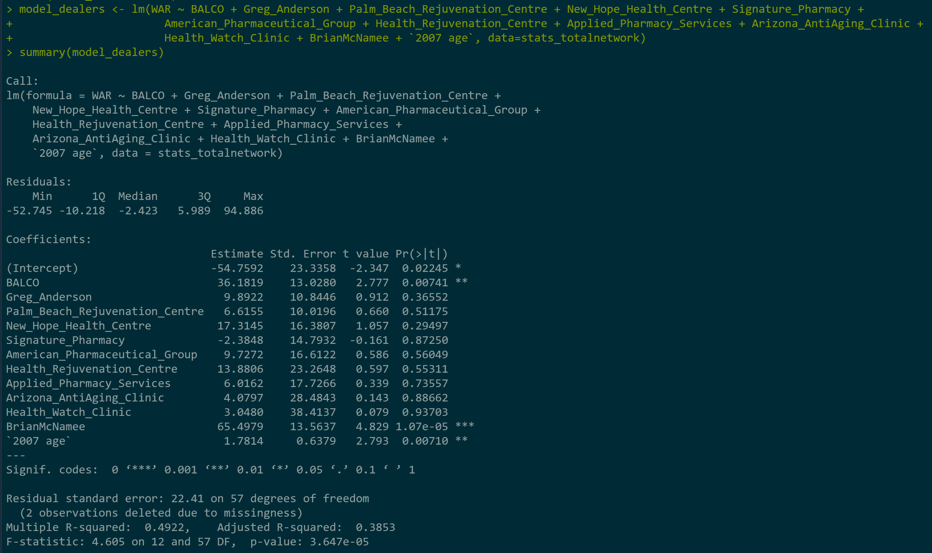
Are certain players "better" because they got drugs from certain dealers?
We built this regression to show whether getting drugs from certain dealers results in better performance by players. In this case, we used WAR to indicate player performance.
We used all drug dealers except Kirk Radomski as binary dependent variables. We left Radomski out in order to use him as a reference point for all other dealers in the network since he is the most central dealer in our network and most players get their drugs from him. This makes him a good baseline.
We found that most dealers resulted in positive coefficients, indicating that players that get their drugs elsewhere and not from Radomski, had higher WAR on average.

Slide 13
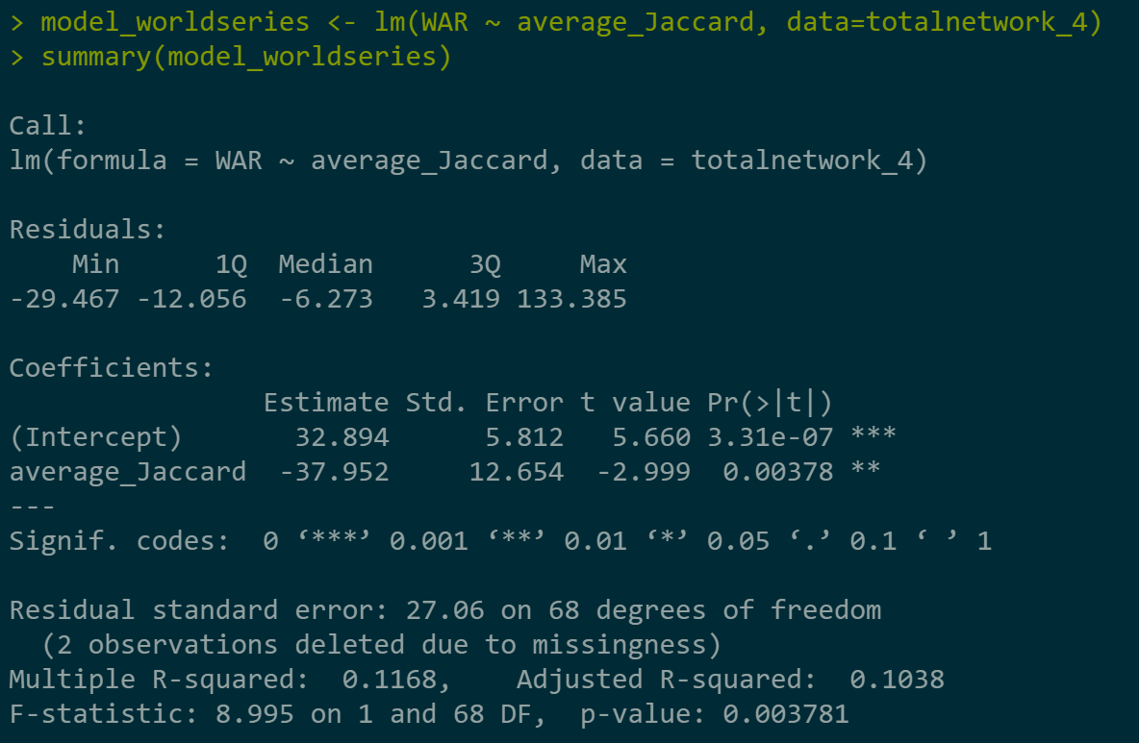
How does similarity among players and the dealers they get their drugs from influence a player’s career performance?
This regression tells us that an increase in average Jaccard similarity actually results in a decreased total WAR, all else equal.
Why might this be? One prediction - most players are buying cheaper drugs, so they’re more connected and, because of the worse drugs, have a lower WAR.
In this context, similar to a lemons problem - nobody really knows the difference in drug quality, so they buy from the cheaper suppliers, leaving much less business for people with good drugs.

Slide 14
Next Steps
In our next steps, we would like to explore collecting more data that we could include in our analysis and regressions
Performance statistics
Number of teams played for
Continue with regression analysis to answer more questions
Does a player’s location influence his ties with drug suppliers?
Are more experienced players more likely to have ties with more highly-connected suppliers?

Slide 15
Questions/Suggestions?

Slide 16
Sources
http://files.mlb.com/summary.pdf
https://www.baseball-almanac.com/legendary/Mitchell_Report.shtml
https://www.nytimes.com/2006/05/07/books/chapters/0507-1st-fain.html
https://www.baseball-references.com
Original dataset from Demetrius Lewis

